Slide 1
JAMBOREE

Slide 2
TABLE OF CONTENTS
01
04
About the Project
Sneak Peek
02
05
Major Requirements
Project Stages
03
06
Project Goals
Our Team
Here you could describe
the topic of the section
Here you could describe
the topic of the section
Here you could describe
the topic of the section
Here you could describe
the topic of the section
Here you could describe
the topic of the section
Here you could describe
the topic of the section

Slide 3
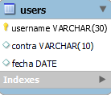
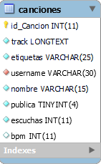
Información sobre la base de datos
Está compuesta por las tablas users y canciones.
El atributo username de la tabla canciones es clave foránea de la clave primaria de la tabla users.

Slide 4

Web Audio API
Context()
Transport()

Slide 5
Implementación en JamBoree
ToneAudioBuffers
Kick.wav
Player()
.buffer cada ToneAudioBuffer
.toDestination()
Play()
Tone.loaded()
scheduleRepeat(t)
Draw.schedule()
Player[i].start(“+0,1”)
Snare.wav
Hihat.wav
Clap.wav

Slide 6
Lectura del tema
ID?
getTrack()
leerTrack()
URLsearchParams
tracks=JSON.parse(track)
getTrack()
fetch(server.php).then(track)
leerTrack()
addClass(“marked”)
if (beat == 1)
Creación desde cero
Carga desde servidor

Slide 7
ACCIONES TRAS CARGA
REPRODUCCIÓN
GUARDADO
Ver imagen
Ver imagen

Slide 8
FUNCIONALIDAD EN FORO/AUDIOTECA
PROGRAMMING
DATABASE
WEB DESIGN
$.getScript()
FORO

Slide 9
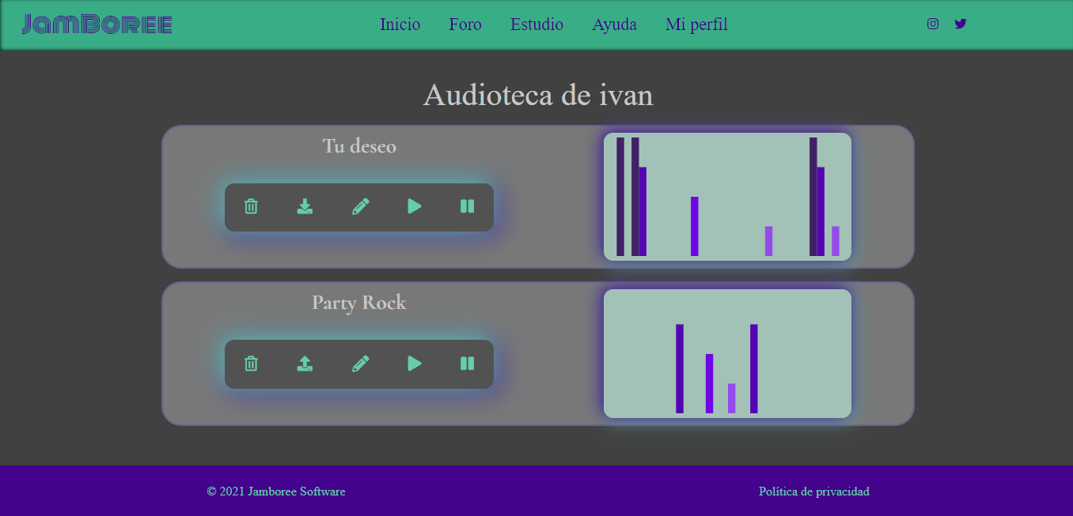
Audioteca

Slide 10
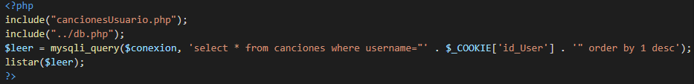
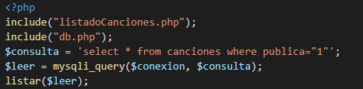
Listado canciones
AUDIOTECA
FORO

Slide 11
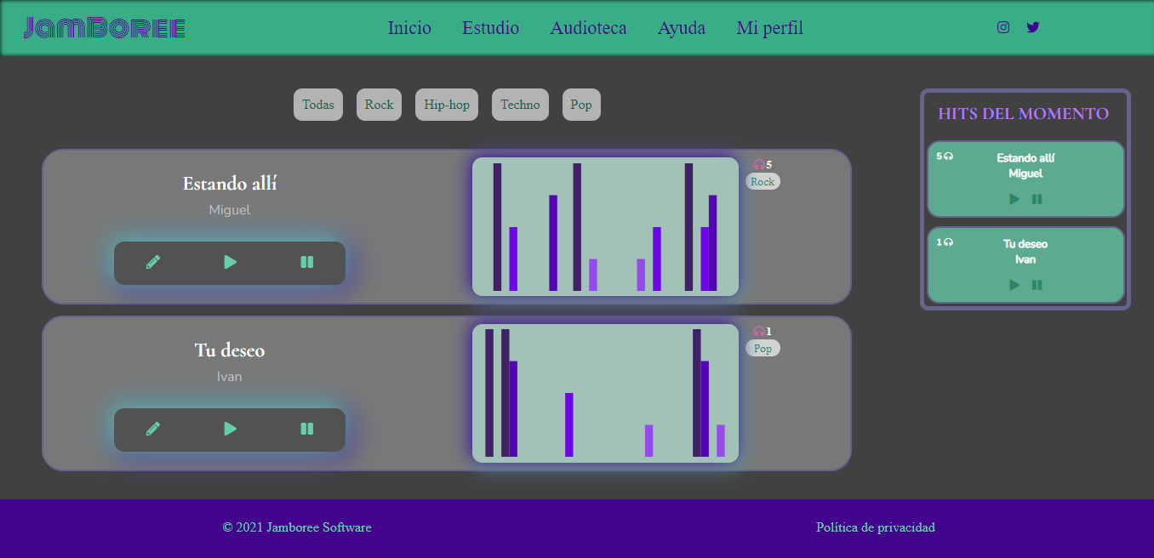
Foro

Slide 12
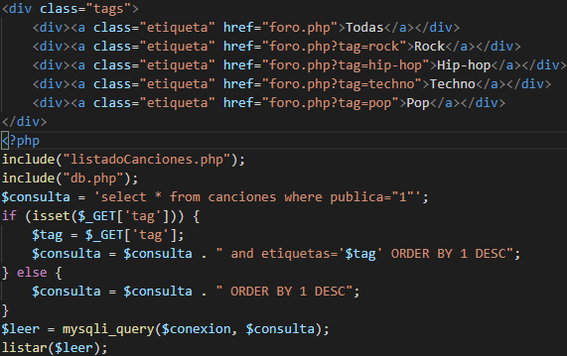
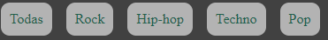
Filtro Foro

Slide 13
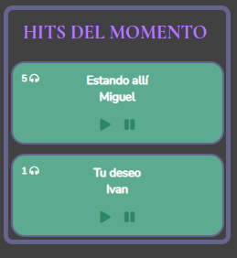
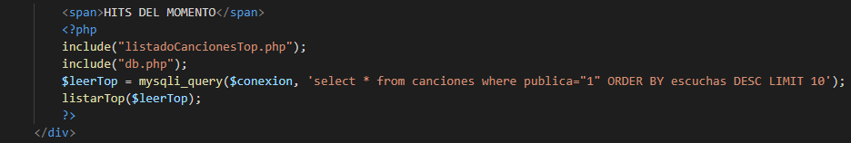
Hits del momento

Slide 14
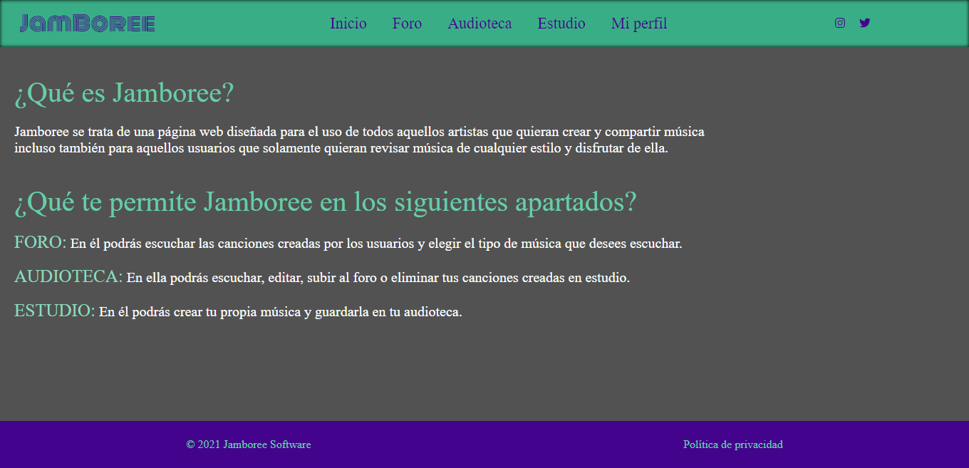
Ayuda

Slide 15
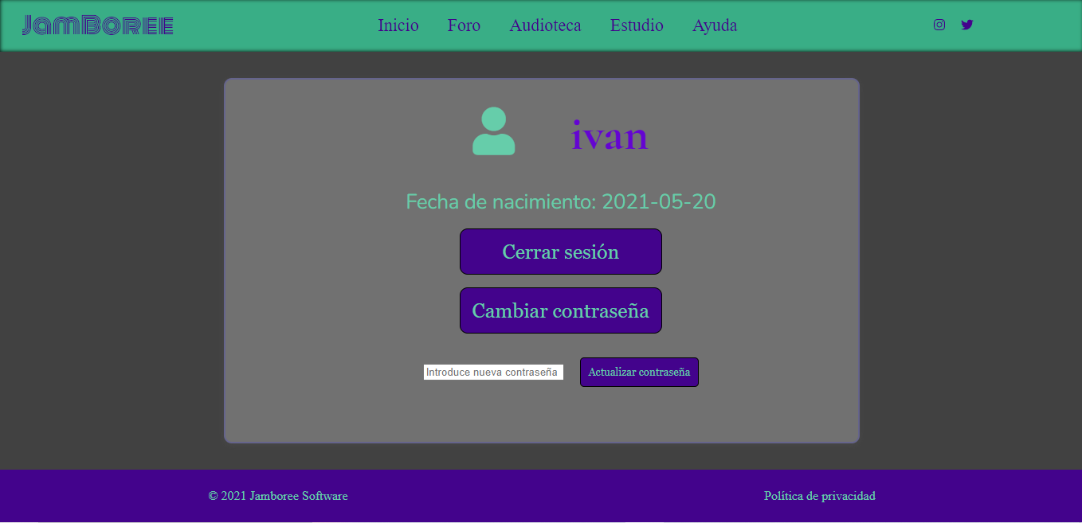
Mi perfil

Slide 16
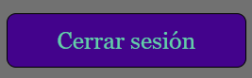
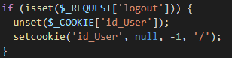
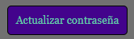
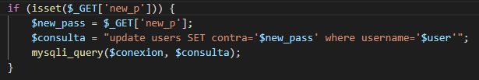
Cerrar sesión y cambiar contraseña

Slide 17
ABOUT THE PROJECT
Mercury is the closest planet to the Sun and the smallest one in the Solar System—it’s only a bit larger than our Moon. The planet’s name has nothing to do with the liquid metal since it was named after the Roman messenger god, Mercury

Slide 18
—SOMEONE FAMOUS
“This is a quote. Words full of wisdom that someone important said and can make the reader get inspired.”

Slide 19
NOW
POOR DESIGN
PROGRAMMING MISTAKES
LACK OF ADAPTABILITY

Slide 20
FUTURE
BRANDING
POSITIONING
ADAPTABILITY

Slide 21
OUR GOALS
EXPANSION
POSITIONING
USABILITY
Neptune is the fourth-largest planet in our Solar System
Venus has a beautiful name and is the second planet from the Sun
Despite being red, Mars is a cold place, not hot. It’s full of iron oxide dust

Slide 22
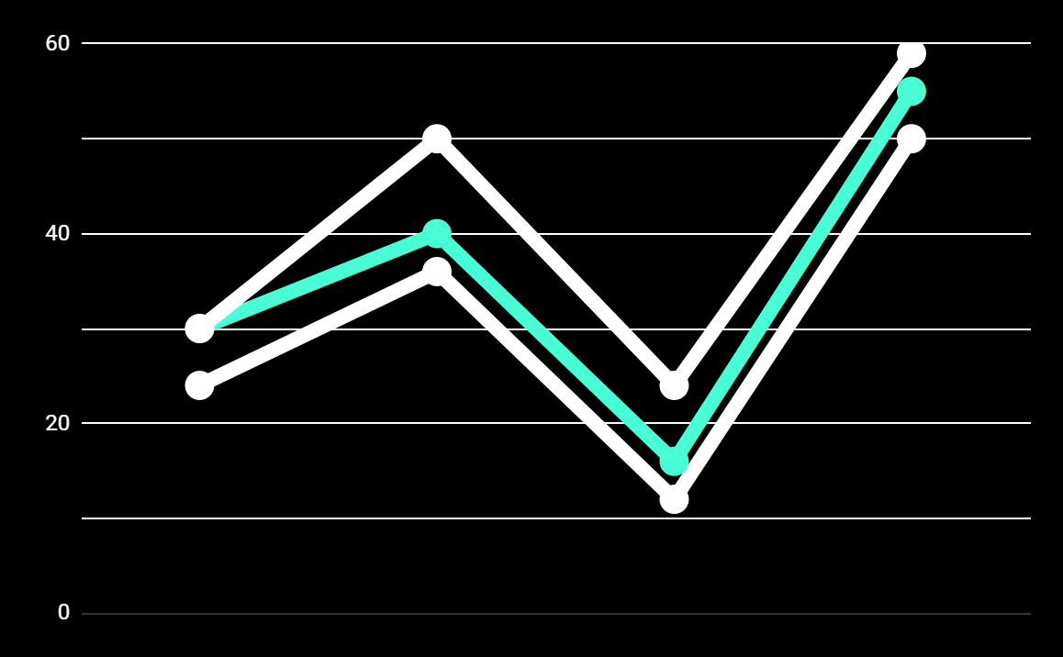
PREDICTED RESULTS
CONVERSIONS NEXT YEAR
+20%
MONTHLY VISITS
+33%
CONVERSION RATE
+40%
ANNUAL ORDERS

Slide 23
SNEAK PEEK
HEADER
TEXT
SLIDER
ICONS

Slide 24
A VIDEO IS A GOOD IDEA
Insert your multimedia content here

Slide 25
PROJECT STAGES
STEP 2
STEP 1
STEP 3
Venus has a beautiful name and is the second planet from the Sun
Despite being red, Mars is a cold place, not hot. It’s full of iron oxide dust
Saturn is a gas giant, composed mostly of hydrogen and helium

Slide 26
OUR TIMELINE
WEEK 1
WEEK 3
BETA
RELEASE
FINAL
VERSION
WEEK 2
WEEK 4
Improvements
Increased traffic
Focus group
Progress review

Slide 27
OUR PARTNERS
MARS
VENUS
MERCURY
Mercury is the closest planet to the Sun and the smallest one in our Solar System
Despite being red, Mars is a cold place, not hot. It’s full of iron oxide dust
Venus has a beautiful name and is the second planet from the Sun

Slide 28



THE TEAM
JENNA DOE
JOHN DOE
JIMMY DOE
You can replace the image on the screen with your own
You can replace the image on the screen with your own
You can replace the image on the screen with your own

Slide 29
THANKS!
Does anyone have any question?
addyouremail@freepik.com
+91 620 421 838
yourcompany.com

Slide 30
CREDITS
This is where you give credit to the ones who are part of this project.
Presentation template by Slidesgo
Icons by Flaticon
Infographics by Freepik
Images created by Freepik
Author introduction slide photo created by Freepik
Text & Image slide photo created by Freepik

Slide 31
RESOURCES
Did you like the resources on this template? Get them for free at our other websites.
PHOTOS
Young businessman with hands in his pocket talking on mobile phone
Smiling ethnic woman with gray laptop
Smiling young man busy in texting message to someone
VECTORS
Flat computer engineering concept
Circuit of user experience
Timeline infographic
Logotype collection
Flat social media multimedia player templa
Gradient technology logo template collection
Digital marketing landing page template
Colorful responsive landing page
Modern web design concept with hand drawn style
App development concept with flat design

Slide 32
Instructions for use
In order to use this template, you must credit Slidesgo by keeping the Thanks slide.
You are allowed to:
- Modify this template.
- Use it for both personal and commercial projects.
You are not allowed to:
- Sublicense, sell or rent any of Slidesgo Content (or a modified version of Slidesgo Content).
- Distribute Slidesgo Content unless it has been expressly authorized by Slidesgo.
- Include Slidesgo Content in an online or offline database or file.
- Offer Slidesgo templates (or modified versions of Slidesgo templates) for download.
- Acquire the copyright of Slidesgo Content.
For more information about editing slides, please read our FAQs:
https://slidesgo.com/faqs

Slide 33
Fonts & colors used
This presentation has been made using the following fonts:
Roboto
(https://fonts.google.com/specimen/Roboto+bold)
Roboto
(https://fonts.google.com/specimen/Roboto+Thin)
#48ffd5
#0e2a47
#ffffff

Slide 34





Storyset
Create your Story with our illustrated concepts. Choose the style you like the most, edit its colors, pick the background and layers you want to show and bring them to life with the animator panel! It will boost your presentation. Check out How it Works.
Pana
Amico
Bro
Rafiki
Cuate

Slide 35
Use our editable graphic resources...
You can easily resize these resources without losing quality. To change the color, just ungroup the resource and click on the object you want to change. Then, click on the paint bucket and select the color you want. Group the resource again when you’re done. You can also look for more infographics on Slidesgo.

Slide 38
JANUARY
FEBRUARY
MARCH
APRIL
MAY
JUNE
PHASE 1
Task 1
Task 2
PHASE 2
Task 1
Task 2
JANUARY
FEBRUARY
MARCH
APRIL
PHASE 1
Task 1
Task 2

Slide 41
...and our sets of editable icons
You can resize these icons without losing quality.
You can change the stroke and fill color; just select the icon and click on the paint bucket/pen.
In Google Slides, you can also use Flaticon’s extension, allowing you to customize and add even more icons.

Slide 42
Educational Icons
Medical Icons

Slide 43
Business Icons
Teamwork Icons

Slide 44
Help & Support Icons
Avatar Icons

Slide 45
Creative Process Icons
Performing Arts Icons

Slide 46
Nature Icons

Slide 47
SEO & Marketing Icons

Slide 48


